Slide 1


Power BI
By: Ramakrushna Mohapatra
Founder Of GrowTechie

Slide 2
Course Content
Introduction to Power BI
Chart Pie chart
Donut Chart
Funnel Chart
Ribbon Chart
Line Chart
Area Chart
Combo chart
Scatter Chart
Waterfall Chart
Tree Map Chart
Maps Filled - Maps
Tables Conditional formatting
Gauge Chart
Cards
Multi Row cards
Filter Drill
Slicer-Text Number- Date
Advance Chart-Animated Bar chart-Word cloud-Sunburst
Advanced chart - Play Axis - Scrollbar - Infographic
Inserting Object in Power BI - text - images - shapes
Inserting Object in Power BI - Drill Through - bookmark
Creating report in Power BI
Publishing in Power BI
Power BI Dashboard
How to refresh data in power bi
Introduction To Power Query E
Adding Removing Rows
Text Add Column Transform Column
Number Add Column Transform Column
From Date Add Column Transform Column
Appending sheets
Merging sheets
Columns from example Conditional column
Fill group by transpose
Keep and remove columns and rows
Importing Dataset To SQL And Connecting To Power BI
Creating and deleting relationships Normalization 1NF 2NF 3NF
Denormalization E
OLTP VS OLAP 5
Dax Language

Slide 3
What is Power BI?
A Data visualization & Business intelligence tool that convert data from different data sources to interactive dashboards and BI reports

Slide 4
Why Power BI?
Great Speed
User Friendly
Eye Catching and Interactive Dashboards
Max Features (Functions & Visuals)
Cheapest tool
Data Connectivity - Can connect More than 100 Data sources
Notes:
User Friendly means even a guy from non tech can learn. Different types of formatting can be done
Ample no of visuals present here. From third party also we can do

Slide 5
How Power BI Works?
Power BI Desktop - Used to create reports.
Power BI Service - Used to publish the reports.
Notes:
User Friendly means even a guy from non tech can learn. Different types of formatting can be done
Ample no of visuals present here. From third party also we can do

Slide 6
Power BI: Collection Of Components
Power BI Query: For cleaning the data
Power Pivot: Create relationship between multiple data sources
Power View: To create different types of chart
Power BI Services: It’s a SAAS based online service to share
Notes:
User Friendly means even a guy from non tech can learn. Different types of formatting can be done
Ample no of visuals present here. From third party also we can do

Slide 7
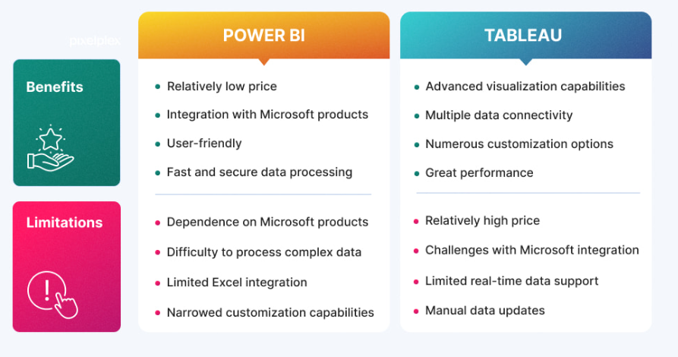
Tableau vs Power BI
Notes:
User Friendly means even a guy from non tech can learn. Different types of formatting can be done
Ample no of visuals present here. From third party also we can do

Slide 8
Power BI Report Servers?
On premises Solution: Org Host BI reports within their private n/w.
Report Publishing:
Limited Collab: BI server is designed for sharing reports within the organization by sharing externally and collab without internet.
Schedule data refresh: To ensure data is upto date.
Authentication:
Customization: Org have control over customization & feel the report portal
Notes:
User Friendly means even a guy from non tech can learn. Different types of formatting can be done
Ample no of visuals present here. From third party also we can do

Slide 9
Power BI Service?
Cloud based solution:
Sharing & Collaboration:
Automatic updates:
Embedding:
Mobile Accessibility:
Subscription & Licencing:
Notes:
User Friendly means even a guy from non tech can learn. Different types of formatting can be done
Ample no of visuals present here. From third party also we can do

Slide 10
Flow In Power BI
Requirement Gathering
Stakeholders in Projects
Raw Data overview
Connecting Data with PowerBI
Data Cleaning
Data Processing
Data Modelling
BG Design in powerpoint
Data Visualizations/Chart Design
Report/Dashboard building
Insights
Notes:
User Friendly means even a guy from non tech can learn. Different types of formatting can be done
Ample no of visuals present here. From third party also we can do

Slide 11
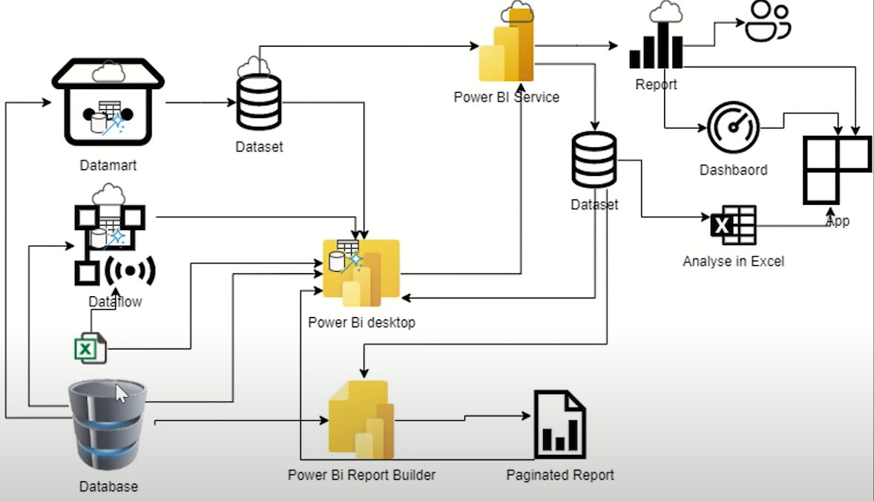
Power BI Ecosystem
Notes:
User Friendly means even a guy from non tech can learn. Different types of formatting can be done
Ample no of visuals present here. From third party also we can do

Slide 12
Installing Power BI
To Download latest version of Power BI
https://www.microsoft.com/en-us/download/details.aspx?id=58494
Notes:
User Friendly means even a guy from non tech can learn. Different types of formatting can be done
Ample no of visuals present here. From third party also we can do

Slide 13
Licensing & Pricing
https://powerbi.microsoft.com/en-in/pricing/
Notes:
User Friendly means even a guy from non tech can learn. Different types of formatting can be done
Ample no of visuals present here. From third party also we can do

Slide 14
Three Important Steps
Get Data in power BI: Locating the data and using an appropriate type
Choose The Visualization: Chart types to be created
Select The Field To Be Worked On: Movement of field in desired area
Notes:
User Friendly means even a guy from non tech can learn. Different types of formatting can be done
Ample no of visuals present here. From third party also we can do

Slide 15
Load vs Transform
Load the data without interfering the Power BI
In Transform we will directly go to the Query editor page where we can clean, modify, update and delete anything related to that dataset.
Notes:
User Friendly means even a guy from non tech can learn. Different types of formatting can be done
Ample no of visuals present here. From third party also we can do

Slide 16
First Project
Covid19 World dataset.
Dataset Link:
Notes:
User Friendly means even a guy from non tech can learn. Different types of formatting can be done
Ample no of visuals present here. From third party also we can do

Slide 17
Inbuilt Column Transformations
Removing Columns/ Remove Other Columns:
* Identify the columns to be removed
* Use Appropriate functions or operations to delete the columns
Naming/Renaming Columns:
Reordering/Sorting Columns:
Adding/Custom Columns:
* Define rule or computation for the new columns
* Add column with calculated values
Notes:
User Friendly means even a guy from non tech can learn. Different types of formatting can be done
Ample no of visuals present here. From third party also we can do

Slide 18
Inbuilt Column Transformations
Splitting Columns:
* Identify logic for splitting
* Use functions to split the columns
Merging Columns:
Transposing Columns:
* Use transpose function to switch rows & cols
Pivot/Unpivot Columns:
* Choose the pivot/unpivot columns & the pivot values
* Apply the pivot/unpivot operation
Group By:
* Select grouping of columns
Notes:
User Friendly means even a guy from non tech can learn. Different types of formatting can be done
Ample no of visuals present here. From third party also we can do

Slide 19
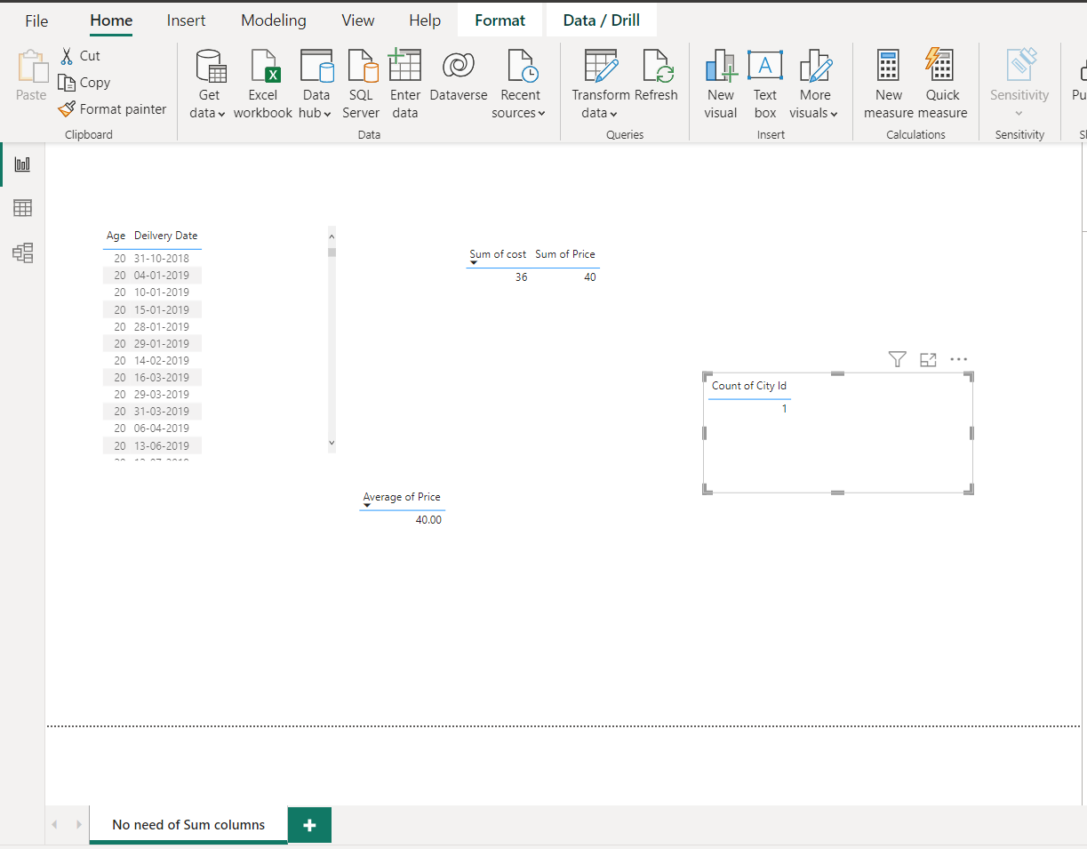
Column Tools
Notes:
User Friendly means even a guy from non tech can learn. Different types of formatting can be done
Ample no of visuals present here. From third party also we can do

Slide 20
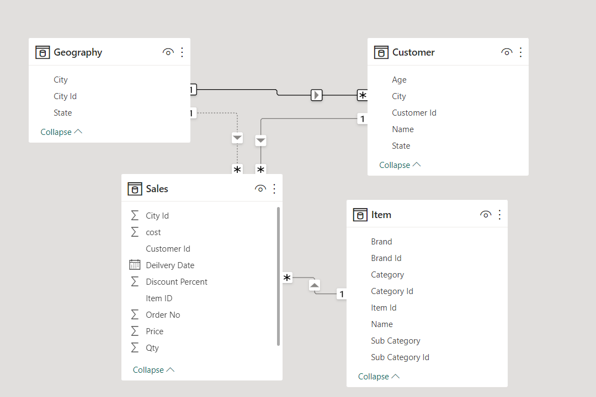
Data Model property Pane & No Join Check
There can’t be more than one path/relationships from one table to other. If there, then delete one.
Here delete Geography-Customer relationship & connect Geography-Sales one.
Notes:
User Friendly means even a guy from non tech can learn. Different types of formatting can be done
Ample no of visuals present here. From third party also we can do

Slide 21
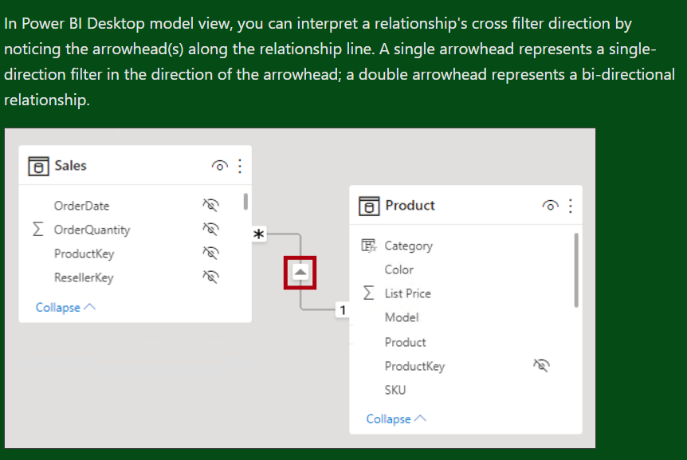
Single vs Bidirectional Join
Customer ID: From customer
Order No: From Sales
ItemID : From Item
Notes:
User Friendly means even a guy from non tech can learn. Different types of formatting can be done
Ample no of visuals present here. From third party also we can do

Slide 22
Theme
Customized Current Theme
Notes:
User Friendly means even a guy from non tech can learn. Different types of formatting can be done
Ample no of visuals present here. From third party also we can do

Slide 23
Calculated Columns & Measures
Calculated Columns: (New Column)
Gross Amount = Sales[Qty] * Sales[Price]
Discount Amount = Sales[Gross Amount] *Sales[Discount Percent ]/100.00
COGS Amount = [Qty] * [Cost]
Measures: (Table-> Right Click -> Measure)
Gross = SUM (Sales[Gross Amount])
Discount = SUM (Sales[Discount Amount])
Net = [Gross] - [Discount]
COGS = SUM (Sales[COGS Amount])
Margin = [Net] - [COGS]
Notes:
User Friendly means even a guy from non tech can learn. Different types of formatting can be done
Ample no of visuals present here. From third party also we can do

Slide 24
Calculated Columns & Measures
DISCOUNTS:
Discount % = DIVIDE ([Discount], [Gross])
Margin % = DIVIDE ([Margin], [Net])
Note!
Measure takes measure and Column takes column. Unless You mentioned any Aggregate function.
Notes:
User Friendly means even a guy from non tech can learn. Different types of formatting can be done
Ample no of visuals present here. From third party also we can do

Slide 25
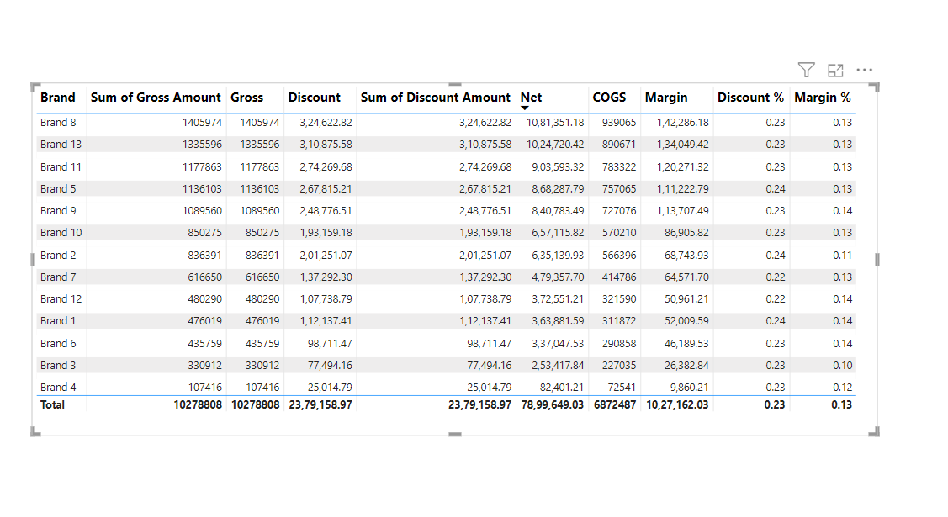
Notes:
User Friendly means even a guy from non tech can learn. Different types of formatting can be done
Ample no of visuals present here. From third party also we can do

Slide 26
Theme
Project-2
Notes:
User Friendly means even a guy from non tech can learn. Different types of formatting can be done
Ample no of visuals present here. From third party also we can do

Slide 27
Theme
Functions
CALCULATE
FILTER
SUM
MIN
MAX
COUNT
DISCOUNT
Notes:
User Friendly means even a guy from non tech can learn. Different types of formatting can be done
Ample no of visuals present here. From third party also we can do

